Slide 1
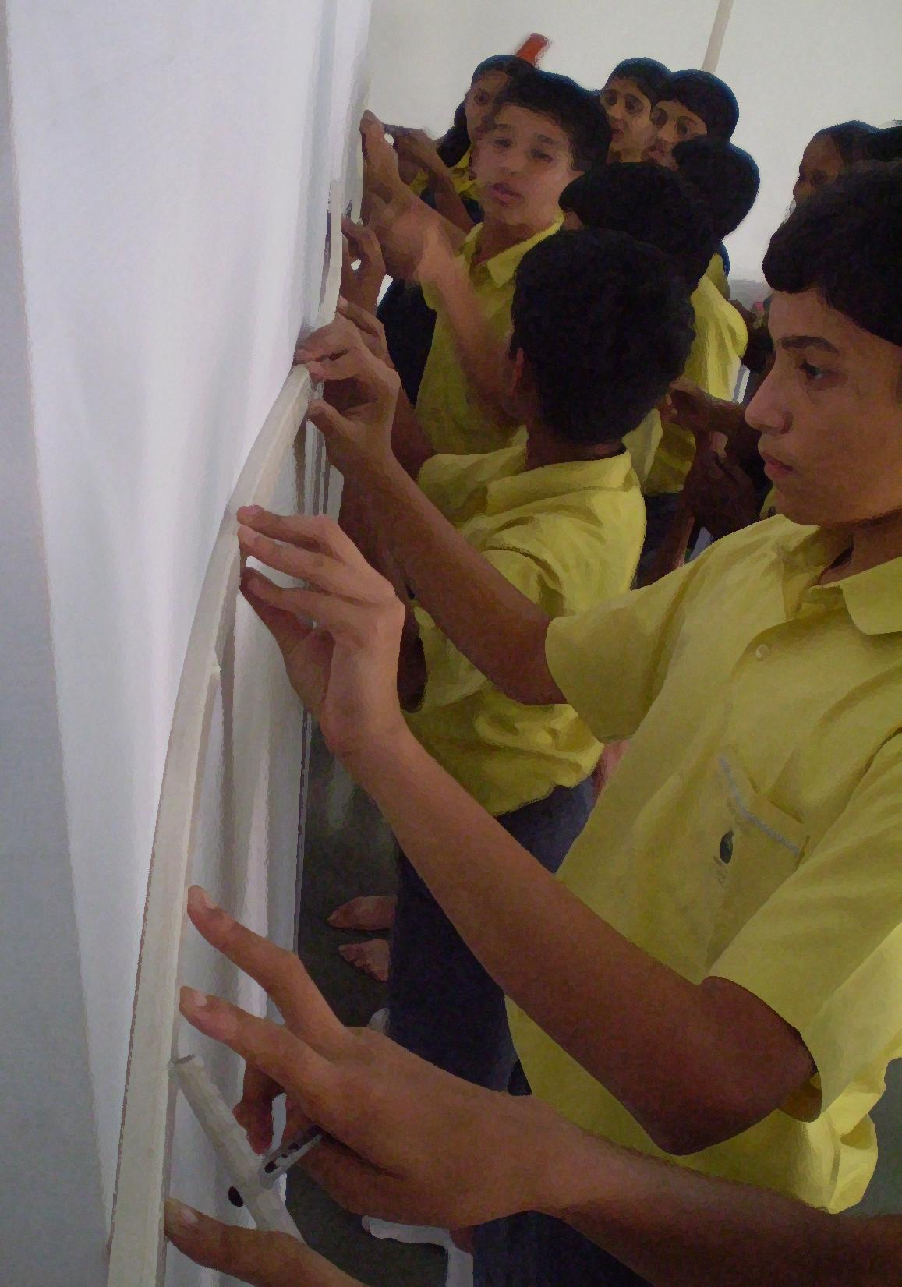
A need for a more exciting Education
Vishwas Parchure
Talk at Lamakaan, Hyderabad
9th Jan 2016.
9096000121 / challops@gmail.com
www.vishwasparchure.com
exciting for whom?

Slide 2
Imagine you have a child 12 years old.
10 years from now, what do you see?

Slide 3
How we see our children 10 years from now
Confident
Bold
Curious
Focused
Responsible
Independent
Self motivated
Practical
Ability to change the world
Notorious
Strong in all manners
Creative
Clarity of thought
Sporting gentleman
Observation
Leadership
Thinking ability
Self respect
Creative
Decision-making

Slide 4
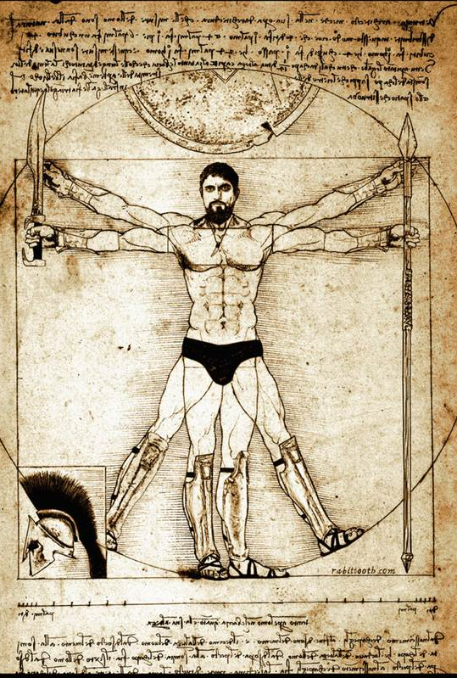
We send our children to School.
Which other living thing does that?
We are the only species
that creates the environment
that creates who we become!
—Land of Childhood

Slide 5
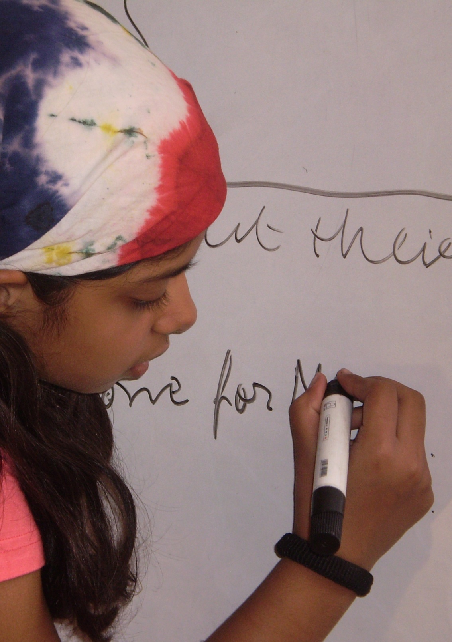
The school is an important place!
The experience of schooling is a powerful changer
The experience is sensory – first!

Slide 6
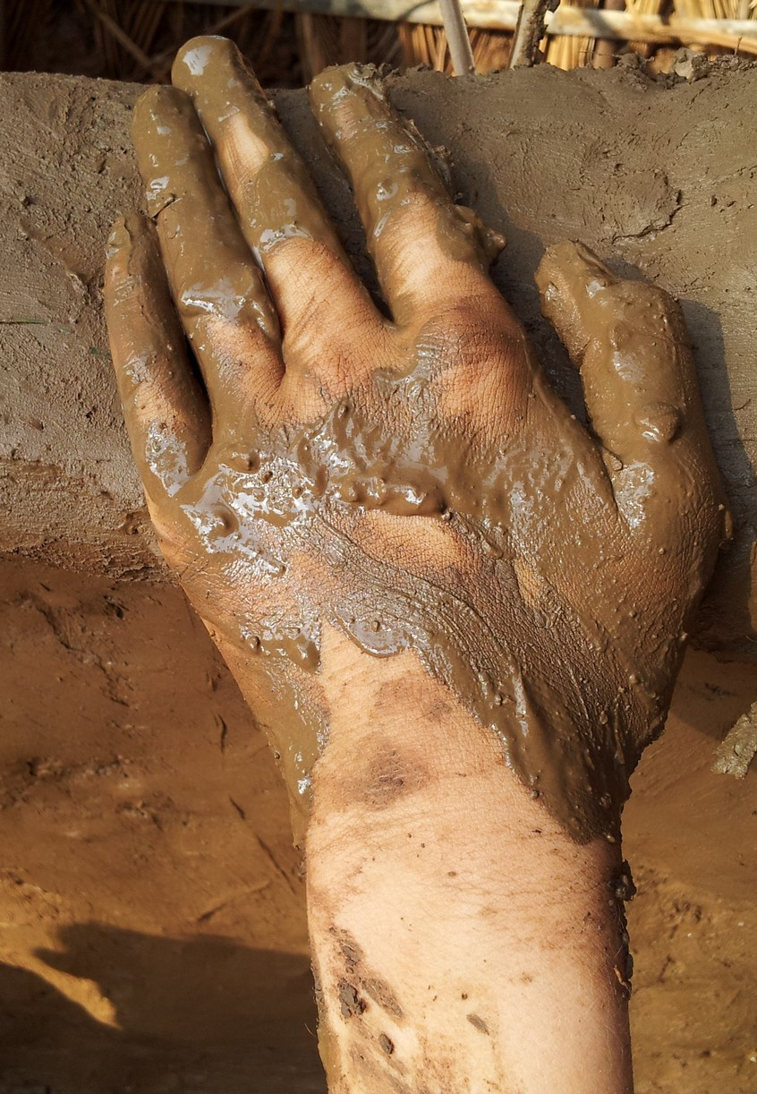
“There is no such thing as bypassing the sensory system;
it is the body-brain partnership’s way of taking in information.”
Susan Kovalik & Karen Olsen

Slide 7
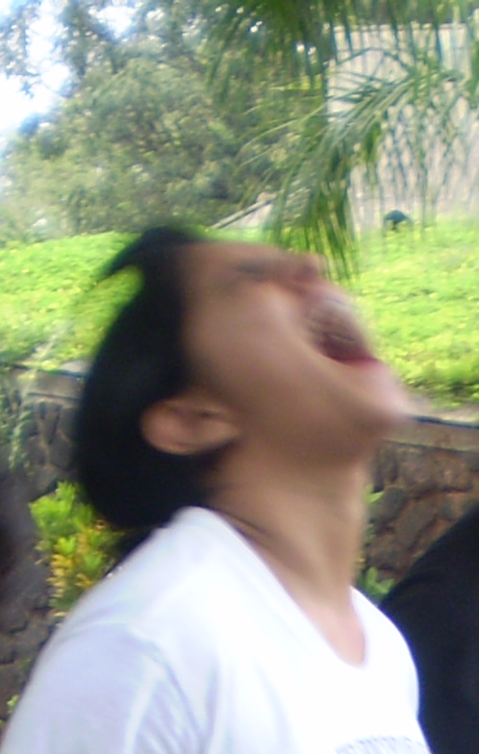
Emotion is the Gate-keeper to Learning and Performance.
And the classroom has emotionl impact!

Slide 8
Lets just play with some ideas for a while.
There is no curriculum
There is no exam
There is no place
You can decide
How many children you want
what you want to do
Where you want to do
Who you want to work with

Slide 9
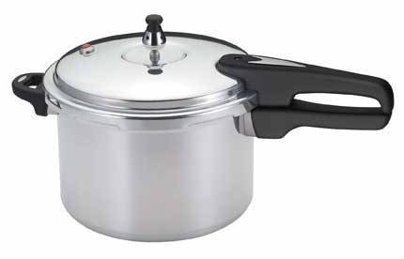
10th standard

Slide 10
9 Body-brain compatible Elements
Absence of Threat
Mastery
Meaningfulness
Immediate Feedback
Collaboration
Choices
Movement
Adequate Time
Enriched Environment

Slide 11
mathematics
Content
Process
Skills
Model making
Designing the classroom
Earth and solar systems
Understanding perspectives
Questioning
why are doors not circular?
notebooks not triangular?
Geometry all around us.
Group work
Symmetry
Ratio & proportion
Perimeter
Area
Parallel lines
2D shapes
Circles and spheres
recognise
question
measure

Slide 12
Civics
Content
Process
Skills
recognise
question
Create
empathy
Dialogue
listening
Self-manage
Power
Equality
Diversity
Discrimination
Fundamental rights
Need of government Administration of a city
Diversity in the classroom
Self governance
Practicing respect
Self designed classroom
Recognising negligence of fundamental rights

Slide 13
Geography
Content
Process
Skills
Create
question
recognise
reference
inference
Dialogue
listening
Self-manage
Decision-making
Plotting
Exploration of daily life
Learning from the past
Beginning of our existence
Concluding from evidences
Effects
physical features on climate
climate on vegetation & wildlife
Geographical vocabulary
Latitudes
longitudes
Our Earth
Universe
Rotation
revolution

